Slide 1
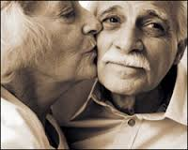
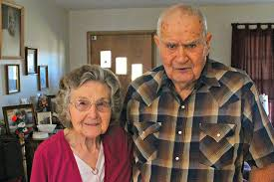
Depression in older adults

Slide 2
Depression in older adults
Definition: not mere “sad mood” . Its persistent sadness, withdrawal from previously enjoyed activities, somatic complaints and sleep difficulties
How common is depression in older adults?
Good News, not very common
1-5 %, increases in people who need home health care, who are hospitalized or who are in nursing homes

Slide 3
Depression
RISK FACTORS: BIOLOGICAL
Chronic Health problems (80% older adults have one chronic health condition and 50% have two or more chronic health issues)
Chronic , persistent pain
Restrictions of diet and mobility
Diabetes
Cardio-vascular issues

Slide 4
Depression
CVA/Stroke
Hypothyroidism
Insomnia
Anxiety
Dementia
Side effect of medications such as Steroids, Beta blockers, anti-parkinson’s,
Ca treatments, meds. Used for Asthma, COPD etc.

Slide 5
Depression
RISK FACTORS: SOCIAL
Stressful life events such as death of spouse, friends
Moving to unfamiliar place
Social isolation
Loss of control , loss of autonomy
( Insert: risk/protective factors in life span)
COMMON PATHWAY SEEMS TO BE CURTAILMENT OF ACTIVITY

Slide 6
Depression
SIGNS OF DEPRESSION IN OLDER ADULTS:
More likely to have somatic complaints
May also complain about anxiety ( which may coexist with depression)
because of apathy, slowness to answer, could be confused for dementia
DIAGNOSTIC TOOLS: Good History taking
(insert PHQ—9, geriatric depression scale –short version)

Slide 7
Depression
TREATMENT OPTIONS: correct the underlying cause when possible
Judicious use of Antidepressant medications.
correct anxiety if it exists
therapy– CBT
ECT
TMS, VNS

Slide 8
Depression
WHAT IS CBT? Therapy based on cognitive model
it is time limited, structured therapy directed toward solving current problems and teaching them skills to modify dysfunctional thinking and behaviour
the way the individual perceives a situation is more closely related to their reaction than the actual situation itself.

Slide 9
